Slide 1
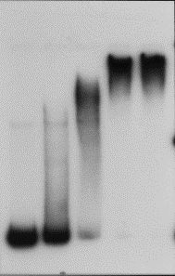
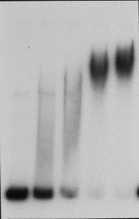
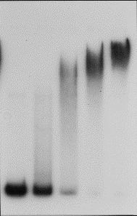
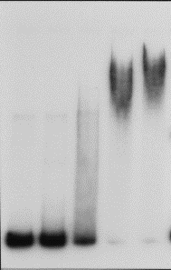
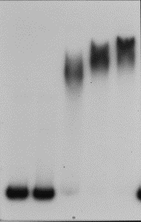
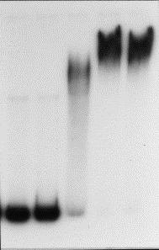
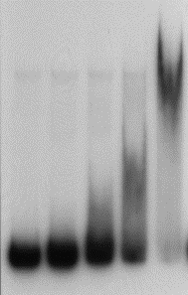
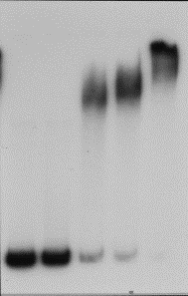
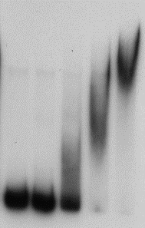
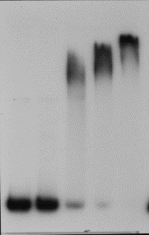
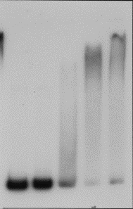
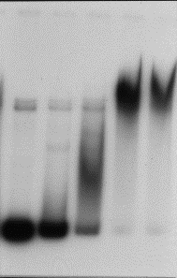
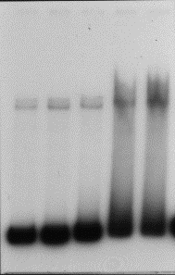
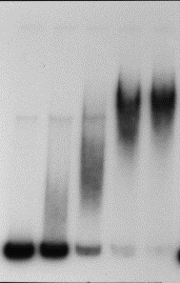
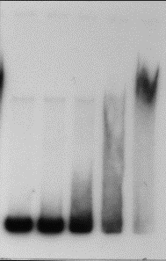
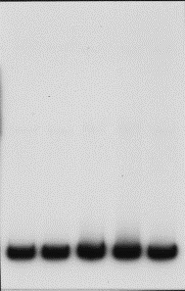
Fig. 1
Cons
wt
mt
0A1
0A2
0A3
0A4
3’AAGCTGT5’
3’AAGCTGT5’
3’ggttcac5’
5’-TGTCGAA-3’
5’-TGTCaAA-3’
5’-cacttgg-3’
5’-TGTCGAA-3’
5’-aGTCGAA-3’
5’-cacttgg-3’
5’-TGTCGAA-3’
5’-TGTCGAA-3’
5’-cacttgg-3’
0A1
0A2
0A3
0A4
-35
-10
-35
-10
0A
P_{V}-σ^{A}
P_{S}-σ^{H}
0A~P
0A~P
0A~P
0A~P
0A~P
Bound
Free
0A box mt
0A box present
none
1234
1
234
2
134
3
124
4
123
Bound
Free
0A box mt
0A box present
12
34
13
24
14
23
23
14
24
13
34
12
Bound
Free
0A box mt
0A box present
234
1
134
2
124
3
123
4
1234
none

Slide 2
Figure legends
Figure 1
Electrophoretic mobility shift assays (EMSA) of bindings of Spo0A~P to the boxes in the spo0A promoter region.
A. The transcription of the spo0A gene occurs from two promoters (Pv and Ps). Locations of the four 0A boxes are indicated relative to the Pv and Ps promoters. Nucleotide sequences of each of the wild type (wt) and mutated 0A boxes (mt) are shown along with the consensus 0A box sequence (cons). A series of 398-bp spo0A promoter fragments containing all combinations of 0A box mutations were amplified by PCR using primers om454 and om467. One of the primer was radiolabeled at the 5’ end and thus the resulting PCR product was radiolabeled. Purified Spo0A was phosphorylated directly by the purified KinC^{ΔTM1+2} (soluble transmembrane deleted KinC) in the presence of ATP in vitro (Devi et al., 2015). Varying concentrations of Spo0A~P (0, 2, 4, 6, and 8 µM, concentrations are based on the purified Spo0A) were incubated with the radiolabeled DNA and analyzed by non-denaturing 6% PAGE. The positions of the unbound (free) and bound DNA are indicated on the left of each of the gel images. Presence or absence of the 0A boxes are indicated on the bottom of each of the images.

Slide 3
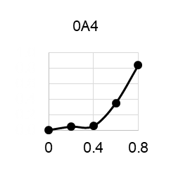
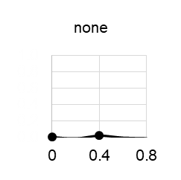
Fig. 2
Fraction bound
Fraction bound
Fraction bound
Spo0A~P concentration (µM)
Kd (µM)
Box
present

Slide 4
Fig. 2. The apparent dissociation constants (µM).
Intensity values of the free DNA bands (Fig. 1B) were measured using Alpha Innotech Fluorchem imager. The fraction of the bound DNA was calculated by subtracting the intensity value of the free DNA from 1 at each Spo0A concentration. Then, the values were plotted on y axis against the Spo0A concentrations on x axis. The apparent binding affinities were calculated as the Spo0A concentration at which 50% of the DNA was bound from a plot of the percent bound versus protein concentration. The graph shows the relative binding affinity of Spo0A~P (0A) for the indicated DNA fragment containing either the wild type (no mutations), single, or combinations of the mutated 0A1*, 0A2*, 0A3*, and 0A4*.

Slide 5
Fig. S1
µM | mean of 4 | STDV
0 | 0 | 0
0.2 | 0.06 | 0.10
0.4 | 0.69 | 0.08
0.6 | 0.97 | 0.03
0.8 | 0.97 | 0.02
Fig. S1
Reproducibility of EMSA
In order to assess the reproducibility of EMSA, we performed four independent experiments using the wild-type DNA and varying Spo0A~P concentrations. The results showing the mean values and standard deviations validated the data obtained by EMSA.

Slide 6
Fig. 3
A
0A1
0A2
0A3
0A4
B
Pv
Ps
0A
0A
0A
0A
0A
0A
0A
0A
C
0A
D
Negative
Pv
Ps
0A
0A1
0A2
0A3
0A4
0A
Pv
Ps
0A
0A
0A
0A
0A
0A
ΔPs
E
F
Positive
0A
Negative
Pv
Ps
0A1
0A2
0A3
0A4
0A
0A
0A
Pv
Ps
0A
0A
0A
0A
0A
ΔPv

Slide 7
Figure 3
Transcription of spo0A is regulated by two promoters through Spo0A~P binding to multiple 0A boxes in the promoter elements.
The transcriptional activity of the spo0A promoters were systematically analyzed using a β-galactosidase reporter assay. Constructs examined are: (A) wild type Pv and Ps promoter, (C) Pv promoter, and (E) Ps promoter. Then, 0A box mutations were systematically introduced into each of the promoter constructs. Each of the resulting promoter fragments was transcriptionally fused to lacZ. Each of the constructs was transferred to the chromosome of the wild type B. subtilis strain as a single copy. Cells were cultured in MSgg and sampled at the indicated time points (BDF). β-Galactosidase activities represent the results of at least three independent experiments with standard deviations. The proposed models for the regulatory mechanisms of spo0A transcription by Spo0A~P binding to the 0A boxes are indicated in panels D and F.

Slide 8
Previously proposed model:
PMCID: PMC3209201 DOI: 10.1128/JB.06057-11
Just-in-time control of Spo0A synthesis in Bacillus subtilis by multiple regulatory mechanisms
Negative
0A1
0A2
0A3
0A4
Pv
Ps
0A
Positive
Negative
0A1
0A2
0A3
0A4
Pv
Ps
0A
FIG. 8. Model for the control of spo0A expression. The upper
panel shows that during the exponential phase of growth, O2 represses
transcription from Ps. Thus, transcripts originating from Pv are the
chief source of mRNA, which due to secondary structure is impaired in
translation. The dotted circle conveys that the identity of the molecule
bound at O2 has not been confirmed as being Spo0AP biochemically.
The lower panel shows that during the transition to stationary phase in
sporulation-inducing medium, Pv is repressed by Spo0AP bound at
O1, and Spo0AP molecules bound at O3 and downstream activate Ps,
overriding repression by O2. Cooperative binding of Spo0AP molecules
renders the switch from Pv to Ps highly sensitive to small changes
in Spo0AP levels. The rate of Spo0A synthesis is enhanced both by
the switch to the strong Ps promoter and the enhanced translatability
of mRNA originating from Ps.

